Slide 1
Topic Prediction using Decision Trees
Seema puthyapurayil
Priya iyer

Slide 2
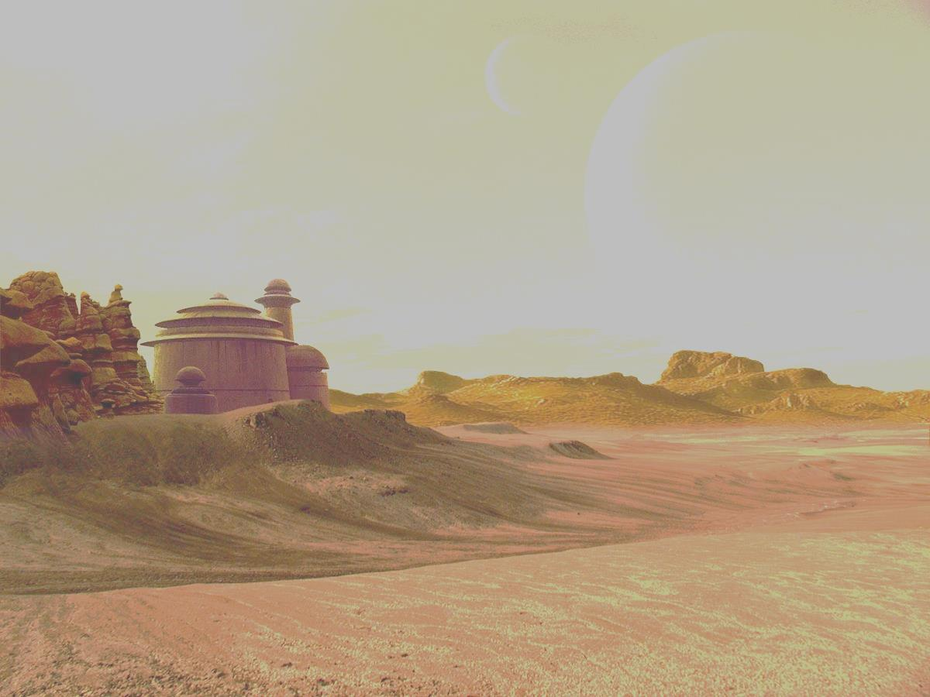
Avaaj otalo Platform
In a country far far away …
Informational platform for farmers
Push notifications

Slide 3
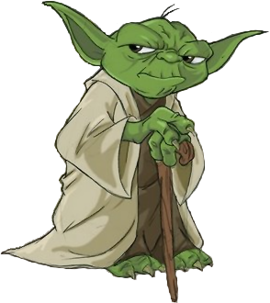
Topic Prediction
” Careful you must be when sensing the future.”

Slide 4
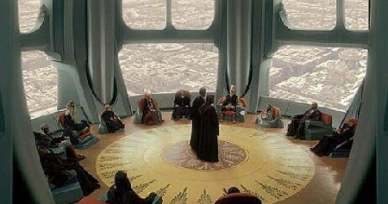
Rationale
Clustering #fail
Increase push notification participation
Researcher
feedback

Slide 5
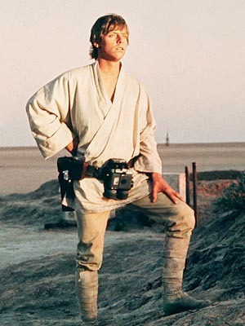
Process
Data Preprocessing
Categorical Data
Conversion
Missing Values
Best features?

Slide 6
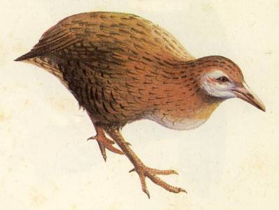
Best Attributes
Call Duration
Month
Crop
Thanks to Weka! (www.cs.waikato.ac.nz/ml/weka)

Slide 7

Training and Classification
Training of Decision Tree using 83,500 records
Information Gain
Measure
Cross validation
accuracy: ~66%

Slide 8
Testing
Randomly selected 200 records
Input : <Crop, duration, month>
Output: <Topic1:p1, Topic2: p2…>
[Cotton, 18, Oct] ->
['Diseases: 8.5%'], ['Other: 3.0%'], ['Pests: 86.1%'], ['Weather: 2.4%']
Average precision: 0.66
Average recall: 0.66
F-Score : 0.65

Slide 9

DEMo

Slide 10
Thank You!

